Slide 1

Unsupervised Learning & Modern Architectures
Week 5: Clustering, and the Evolution of Neural Networks

Slide 2

Unsupervised Learning Shift
Supervised Learning (Past)
Unsupervised Learning (Today)
What happens when we have labels?
What happens when we lack answers?
•
We train algorithms like Decision Trees, SVMs, and KNN.
•
We only have raw data (X) with absolutely no labels (no Y).
•
The goal is to map known inputs (X) to explicit outputs (Y).
•
The goal is for the algorithm to find hidden structures or groupings independently.
•
Acts like a teacher holding an answer key to guide the model.
•
Making sense of millions of data points without an answer key.

Slide 3
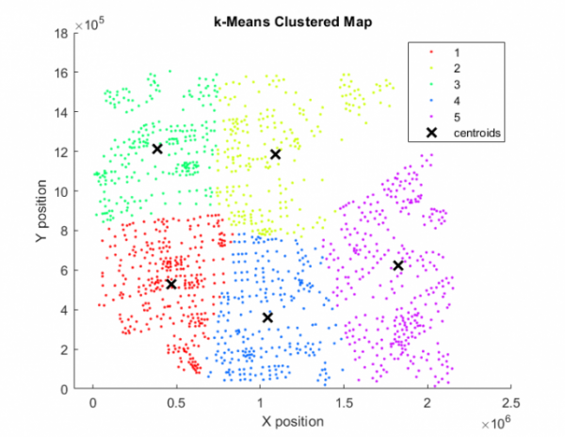

Intro to Clustering
Grouping by Similarity
Clustering is the task of grouping a set of objects so that items in the same group (a cluster) are more similar to each other than to those in other groups.
Real-World Applications:
•
Customer Segmentation: Targeting specific demographics in marketing.
•
Image Compression: Reducing file sizes via color quantization.
•
Anomaly Detection: Identifying fraud patterns in financial data.

Slide 4
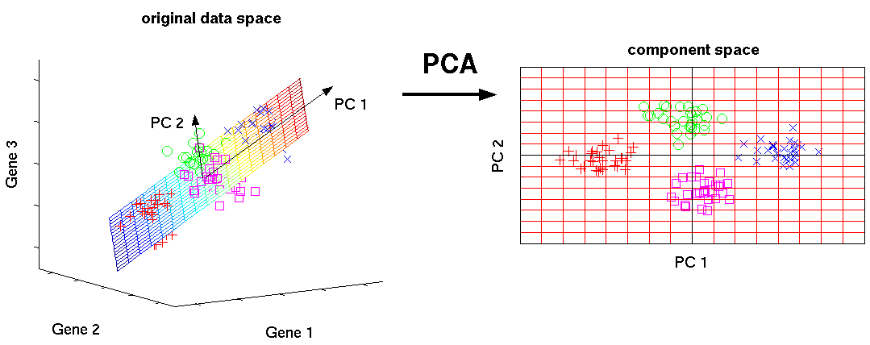
Data Prep: Intro to PCA
Dimensionality Reduction
Principal Component Analysis (PCA) transforms a large set of variables into a smaller one that still contains most of the original variance.
Why use PCA before clustering?
•
Reduces Noise: Strips out less important variables, helping clustering algorithms find the true signal.
•
Curse of Dimensionality: Distance metrics (used in K-Means) lose meaning in highly dimensional spaces. PCA simplifies the space.
•
Visualization: Projects 100D data into 2D or 3D spaces so we can visually verify our clusters.
Notes:
Pca reduces dimensions by squashing them into different Pcs, these Pcs contain the most amount of variance that we can explain from the data.
The squashing happens by applying a dot product between features of the dataset and an eigenvector.
Most variance means most spread, meaning with Pcs we re trying to keep an angle that holds most of the data differences.

Slide 5
K-Means Clustering Concept
K
Finding the Center
K-Means is one of the most popular clustering algorithms. The 'K' is a hyperparameter you must set before running the model.
Number of Clusters
The 'Means' represents the center point (centroid) of each discovered cluster.
Means
How it thinks: It assigns data points to the nearest centroid, attempting to keep the clusters as tight, compact, and distinct as mathematically possible.
The Centroid

Slide 6
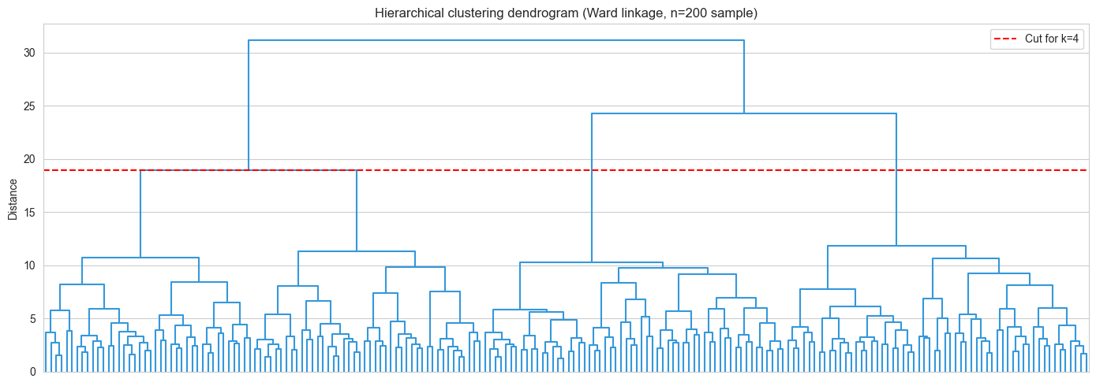
Hierarchical Clustering
Building the Family Tree of Data
Instead of guessing "K" at the beginning, we build a continuous hierarchy of clusters step-by-step.
Agglomerative (Bottom-Up): Every single data point starts as its own isolated cluster. We find the two closest clusters and merge them, repeating until everything forms one giant cluster.
The Dendrogram: A tree-like diagram (seen right) that records the sequence of merges. You can "cut" the tree at any level to get your desired number of groupings visually.
Notes:
We use a dendogram to represent the tree. ( the longer a branch is means there is a bigger distance between two clusters).
We have different types of linkage meaning the "distance" between two groups of points.
The k choice in k means represents the cut in the tree.
There is also divisive approach less common, that starts with 1 cluster and starts splitting dissimilar groups.

Slide 7

ML vs. Deep Learning
Traditional Machine Learning
Modern Deep Learning
Models like SVM, KNN, and Logistic Regression.
Multi-layered Artificial Neural Networks.
•
Requires intensive Feature Engineering.
•
Utilizes powerful Representation Learning.
•
Humans must manually extract and select the most important variables.
•
The algorithm learns how to extract features entirely by itself from raw data (pixels, text, audio).
•
Performance plateaus once the human-engineered features reach their limit of usefulness.
•
Scales exceptionally well with massive amounts of unstructured data and compute power.

Slide 8
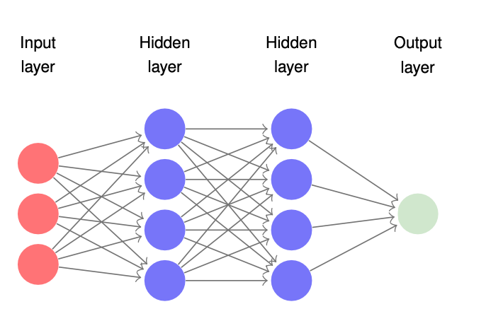
Intro to Neural Networks
The Core Building Blocks
Neural Networks are roughly modeled after the biological connections in the human brain.
The Neuron (Node): Takes inputs, applies a mathematical weight to them, and passes them through an activation function to generate an output signal.
The Architecture:
•
Input Layer: Receives the raw, unadulterated data.
•
Hidden Layers: Where the magic (feature extraction and complex pattern recognition) happens.
•
Output Layer: Produces the final prediction.

Slide 9
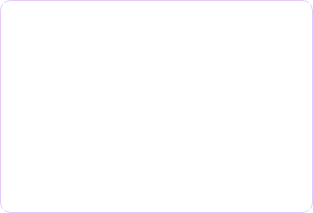
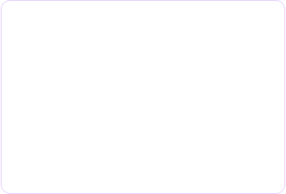
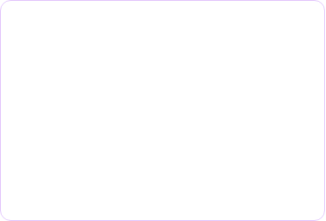
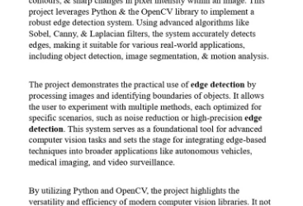
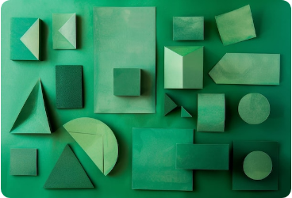
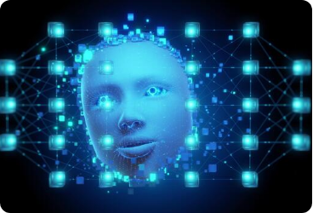
Why is it called "Deep"?
"Deep" simply refers to the vast number of Hidden Layers in the neural network. More successive layers equate to the ability to learn increasingly complex, abstract features.
Layer 1: Edges
Layer 2: Shapes
Layer 3: Objects
Detects raw contrast changes, basic lines, and fundamental edges.
Combines edges to recognize geometric patterns and basic shapes.
Synthesizes shapes to identify highly complex objects or faces.

Slide 10
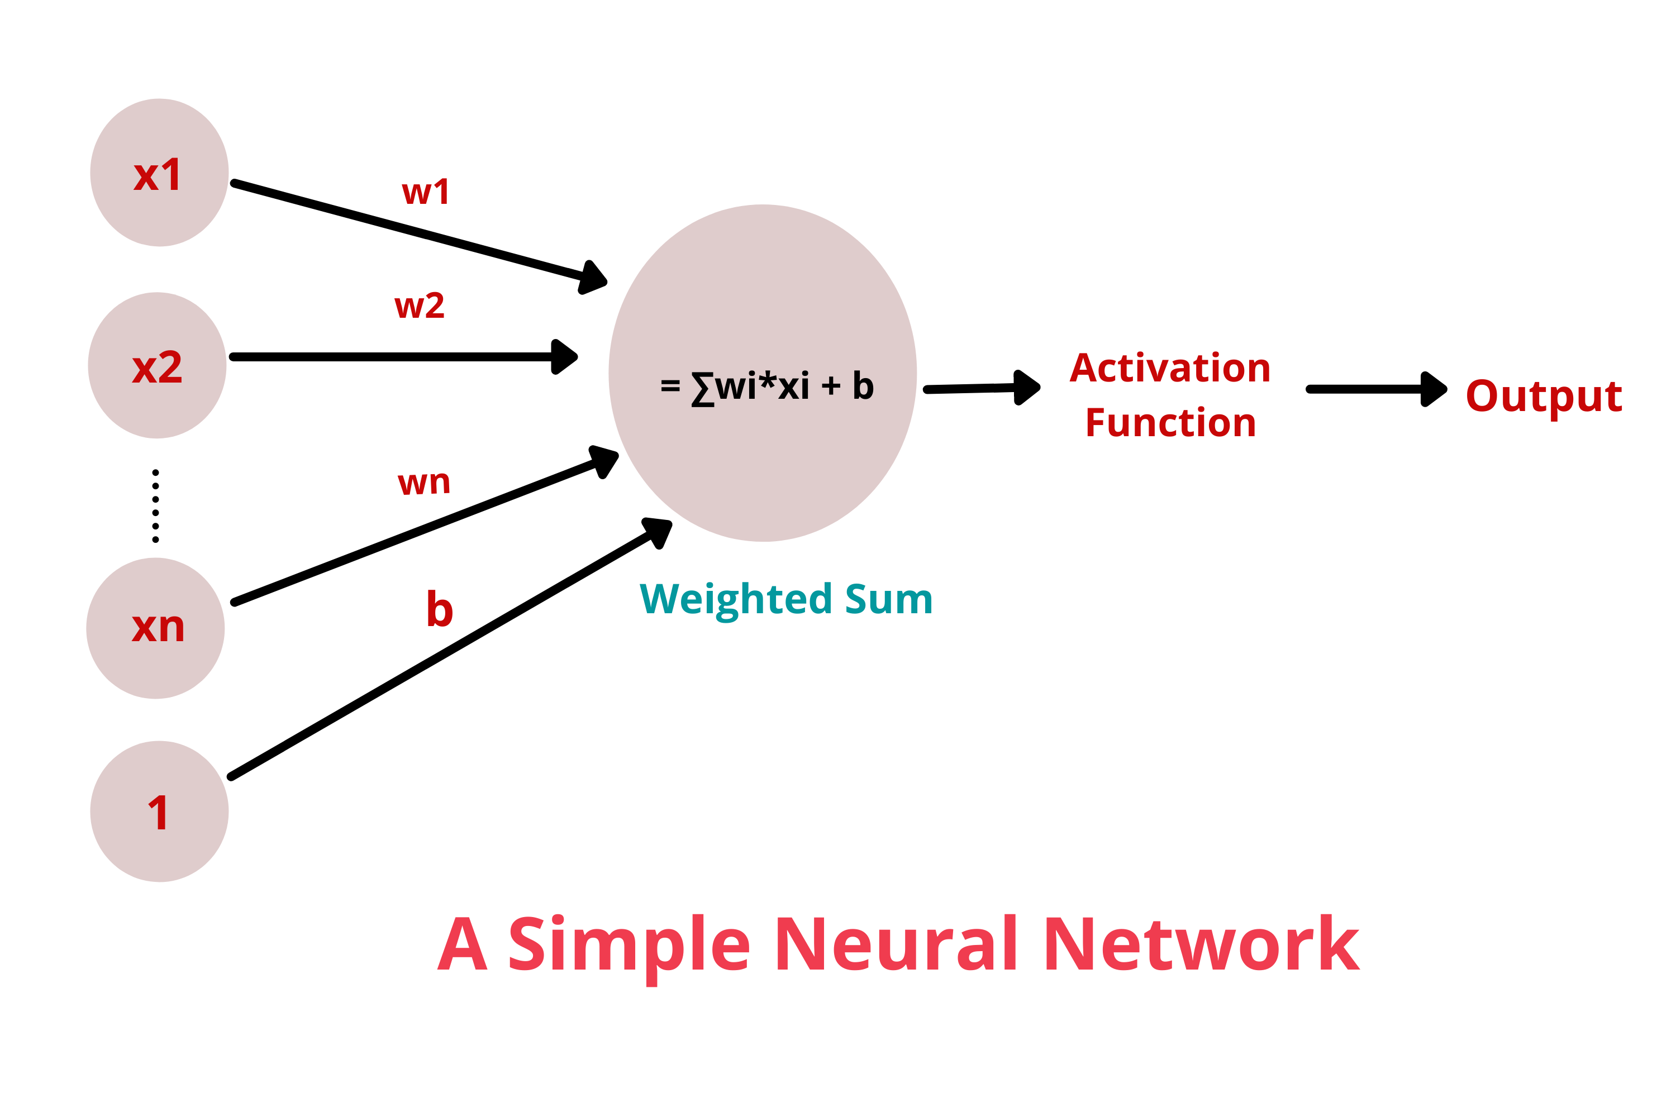
Notes:
Each neuron has weights and biases to help in feature extraction.
But if all neurons are taken it would just be a linear mapping.
The goal of an activation function is to select only neurons whose values are above a certain threshold to enable the network to learn complex patterns.

Slide 11
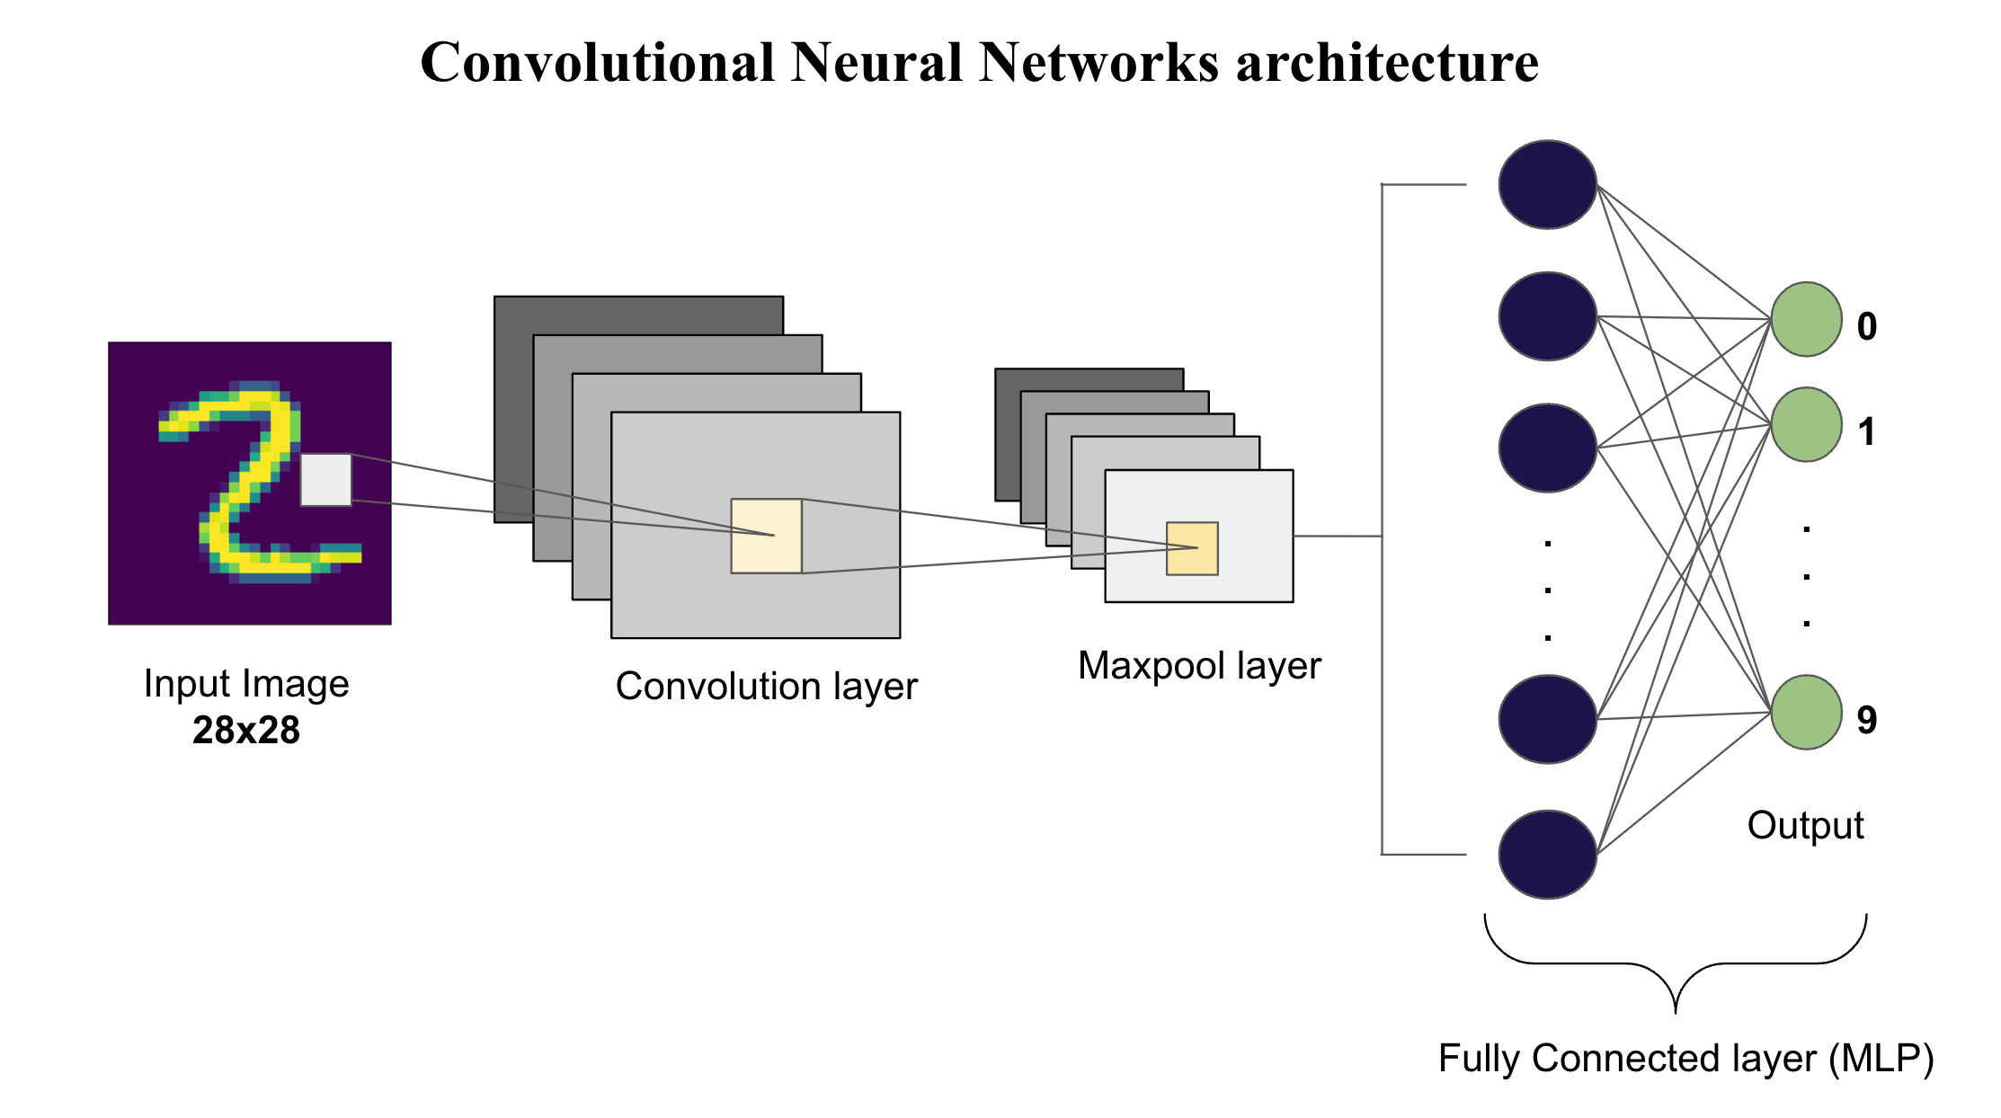
Convolutional Neural Networks
The Visionaries of AI (CNNs)
CNNs are specialized neural networks explicitly designed to process grid-like data, most notably images and video.
How they work:
•
Convolutions: They use mathematically determined "filters" that slide across an image pixel-by-pixel.
•
Spatial Hierarchy: They automatically learn to identify spatial features edges first, then textures, then specific shapes (like an ear or a wheel).
•
Applications: Facial recognition, self-driving car vision, and medical image analysis.
Notes:
A kernel/mask serves as a feature detector that slides through all of the Image pixel.
An activation function serves to activate only certain neurons allowing the network to learn complex patterns.
Pooling serves in reducing the output to make it more interpretable and computationally efficient.

Slide 12

Mastering Time & Sequences
RNNs (Recurrent)
LSTMs (Long Short-Term Memory)
Built for sequential data like text strings, speech, or stock prices.
The upgraded architecture designed to solve the RNN memory flaw.
•
The Memory Loop: They process inputs step-by-step, passing previous information forward to influence the current step.
•
Smart Gates: LSTMs introduce complex mechanisms (Forget, Input, Output gates) inside the node.
•
The Flaw: They suffer from "short-term memory." Over long sequences, they forget the earliest inputs (the vanishing/exploding gradient problem).
•
Selective Memory: They can explicitly choose to remember critical information over thousands of steps, while forgetting irrelevant noise.

Slide 13
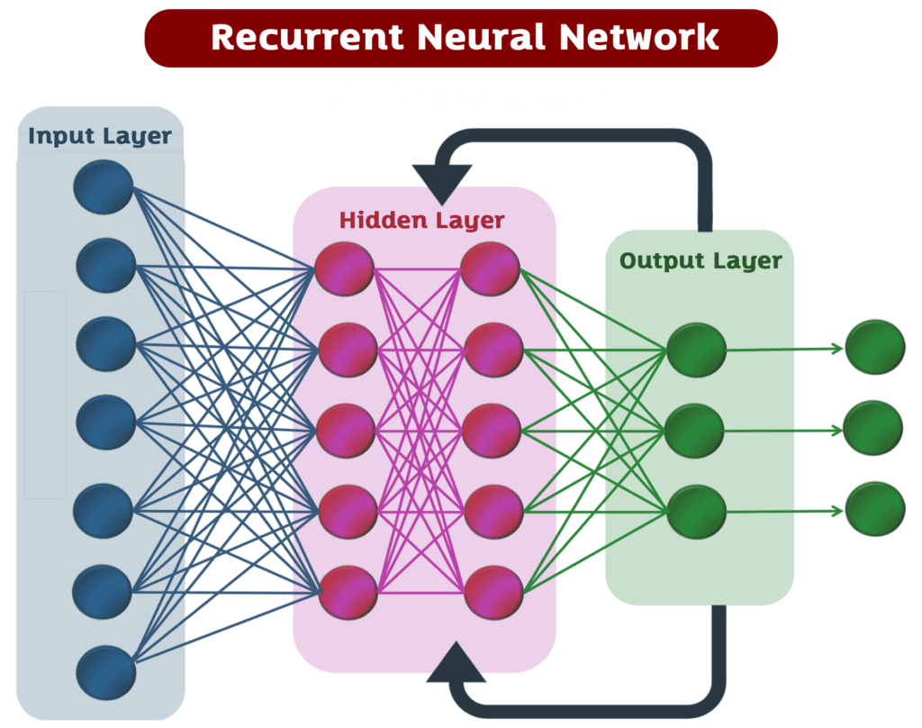
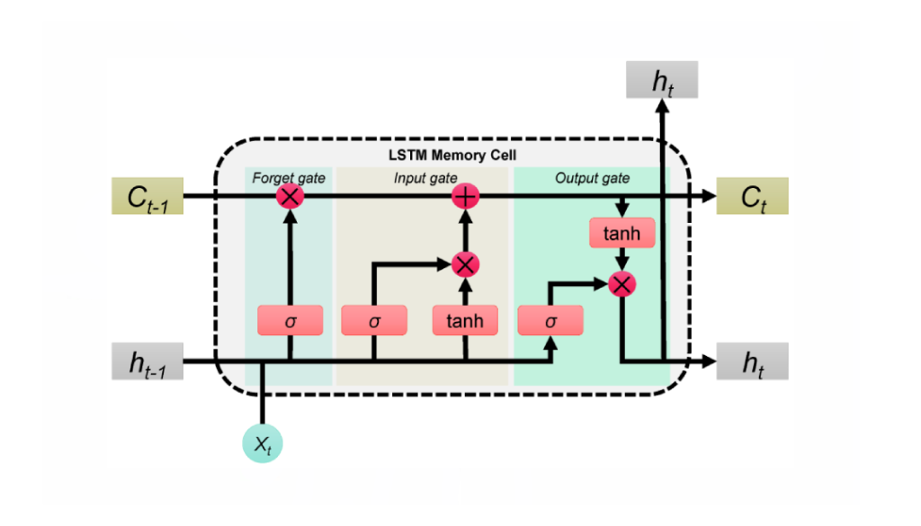
Mastering Time & Sequences
RNNs (Recurrent)
LSTMs (Long Short-Term Memory)
Notes:
An rnn is a neural network that has a hidden state that acts as a memory feeding the output as an input to the hidden layer each time.
But since the rnn applies the same weights after each iteration it can cause the gradient to become very small (vanish) or very big (explode).
Lstm solves this problem by having an additive update instead of a multiplicative one.
An Lstm is composed of three main gates:
Forget Gate: Decides what information from the past is no longer useful and should be thrown away.
Input Gate: Decides which new information from the current step is worth adding to the long-term memory (Cell State).
Output Gate: Decides which parts of the long-term memory should actually be used as the output for the current moment.

Slide 14
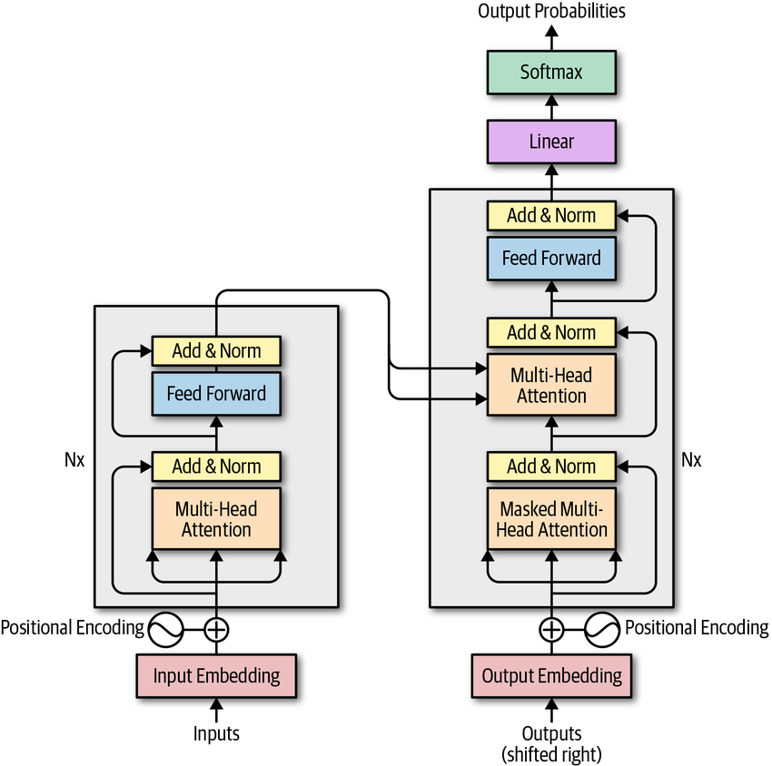
Transformer-Based Models
The Generative AI Engine
In 2017, Transformers revolutionized NLP with a simple concept: "Attention is All You Need."
Parallel Processing: Unlike RNNs that read text word-by-word, Transformers process entire sentences simultaneously, drastically speeding up training times.
Self-Attention Mechanism: The model mathematically weights the relationship between every word in a sequence. It understands context deeply (e.g., knowing the word "bank" means a river vs. a financial institution based on the surrounding sentence).
Powers: ChatGPT, BERT, Claude.
Notes:
Transformer architecture relies on self attention mechanism means giving the weight and importance of each word within the context of a sentence for instance.
There are three main vectors that it calculates:
Query: What am I looking for?
Key: What do I contain?
Value: What information do I provide if I’m a match?
It also has a positional encoding to situate where the word is within a sentence since it doesn t process sequentially the words.
Feed forward network is a typical neural net so the networks learns patterns from the features.

Slide 15
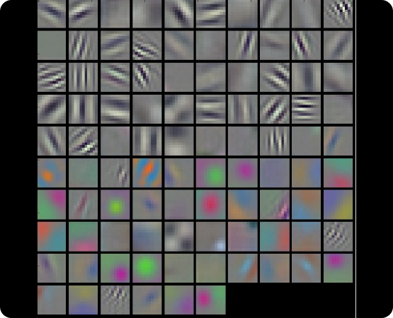
Diffusion Models
Creation through Destruction
Diffusion models generate high-fidelity images by learning to reverse a process of deliberate data destruction.
•
Forward Process (Adding Noise): We take a perfect image and gradually add Gaussian noise step-by-step until it becomes pure, unrecognizable static.
•
Reverse Process (Denoising): We train a Neural Network (typically a U-Net architecture) to predict and remove that noise, step-by-step.
•
The Result: The model can take a canvas of pure random static and "denoise" it into a brand new, never-before-seen image.

Slide 16

Stable Diffusion
1. The Transformer (Text)
2. The Denoising (Image)
How does the model know what to denoise the static into?
The mixed architecture in action.
•
The text embeddings from the Transformer act as a guide.
•
It uses a Transformer Architecture (like CLIP) to read your prompt (e.g., "A cyberpunk cat").
•
They steer the reverse-diffusion (denoising) process, forcing the neural network to sculpt the random static specifically into the shape of a cyberpunk cat.
•
The Transformer encodes your text into mathematical "embeddings" that capture the deep semantic meaning of your words.

Slide 17
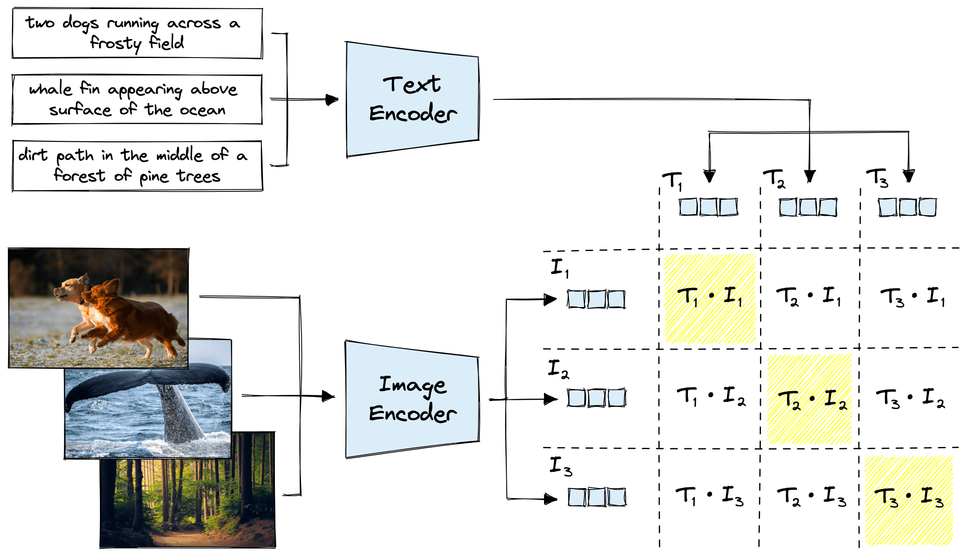
Notes:
It merges between word embeding and image embedings (vectors representing words and images).
The data collected comes from various websites where images are accompanied by captions.

Slide 18







The Neural Network Ecosystem
CNNs
RNNs & LSTMs
Transformers
Diffusion
Spatial Data & Vision. Best for processing pixels and finding patterns in image grids.
Time & Sequences. Best for tracking data over time and maintaining state.
Context & Generation. The undisputed king of Natural Language Processing (LLMs).
Image Generation. Combines Denoising algorithms with Transformers to create art.

